Slide 1




Kansas City Barbeque Society
KCBS Business Affiliate
2023 Program

Slide 2
Kansas City Barbeque Society
“America’s Barbeque Expert”
#1
Organization of Barbeque and Grilling Enthusiasts Globally
20,000
16,000
Members
500
#1
Sanctioning Body for BBQ Food Sport Competitions
+300
Contests Sanctioned Annually
32
Countries

Slide 3

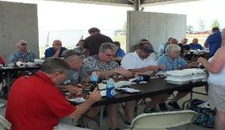
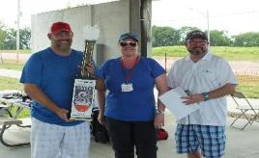
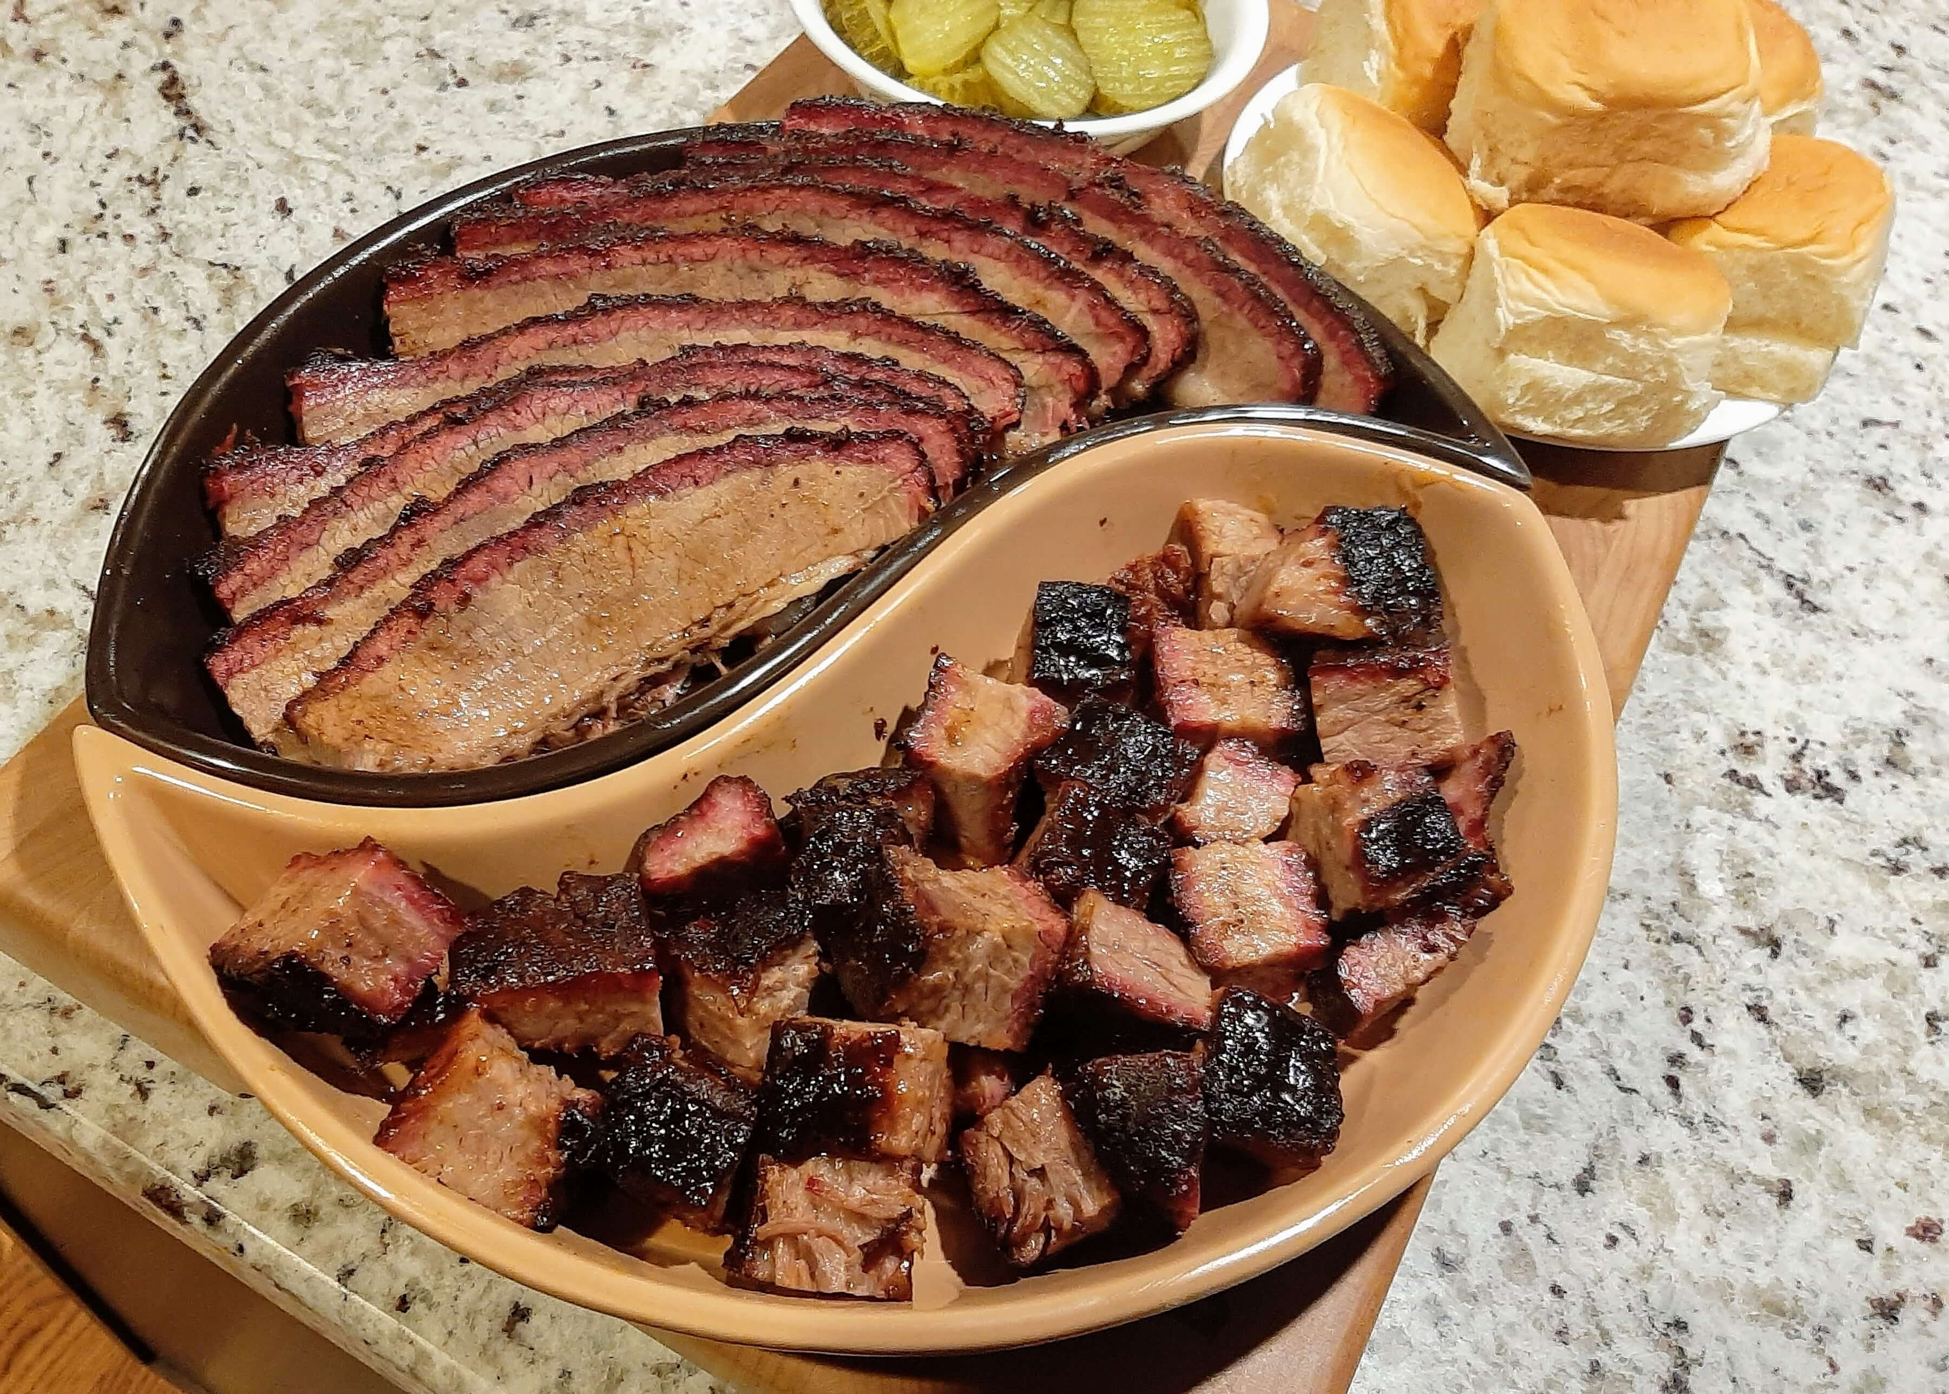
KCBS Members
KCBS membership spans multiple stakeholders
Pitmaster Teams
Judges
Contest Organizers & Contest Reps
BBQ Enthusiasts
Compete in contests large and small
Can enter KCBS Team of the Year points chase
Includes famous professionals, talented amateurs just starting out, and everyone in between
Largest group of KCBS members
Certified Barbeque Judges (CBJs) are trained to provide fair and equitable contests
  12,000+ CBJs
  1,700+ Master CBJs
  200+ CBJs judging over 100 times
Contest Organizers organize and promote individual contests
  Support civic and charitable causes
  Call for teams and judges
Contest Reps oversee execution of contest for team turn-Ins, judging and reporting scores
Passionate about all forms of live-fire cooking
Trusts KCBS for info on the best products, cooks, and trends
Enjoys BBQ and grilling content
Wants to be a part of the ‘club’ and support the growth of BBQ

Slide 4




Connecting People and Brands with the World of Barbeque
Leveraging social media, web, and member communication to engage smoking and grilling enthusiasts
@KansasCityBarbequeSociety
70.4K Followers
@kcbbqsociety
18.6K Followers
@kcbbqsociety
18K Followers
kansascitybarbequesociety
1.6K Subscribers
In addition to social media, KCBS has robust tools to communicate directly with our members:
BullSheet, monthly newspaper
Meat Sheet, mid-month digital newsletter
eBlasts, email to general or targeted membership
Our website, kcbs.us, is the main repository for KCBS information: event listings, membership information, Team of the Year standings, the latest news, judge portal, KCBS gear, partner information, and more.
www.kcbs.us
* Data as of January 2021

Slide 5
KCBS Business Affiliate Program

Slide 6
Barbeque Lovers Welcome Here
Become a KCBS Business Affiliate
Enroll your business or organization in the 2023 KCBS Business Affiliate program and receive these benefits:
Associate your brand with KCBS
Listing in the KCBS Directory on kcbs.us
Receive a certificate that lists you as a KCBS Business Affiliate for display at your business
Receive window clings that can be displayed on your business's front door to drive walk-in traffic
Ability to display the Business Affiliate logo on your website and social media
20% discount on KCBS advertising rates for Bullsheet, website, and social media ads
Attract BBQ & grilling enthusiasts to your business
Becoming a KCBS Business Affiliate supports the mission of KCBS:
Preserving, Celebrating, Promoting, and Educating the public about barbecue as a distinctively American cuisine

Slide 7
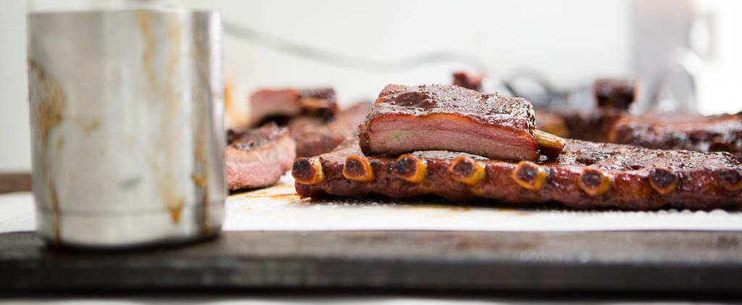
Enroll Today
Become part of the world of BBQ
Who can become a KCBS Business Affiliate? *
Restaurants Municipalities Retailers International Businesses Events
Manufacturers Trade Groups Associations Clubs Publications
How to enroll:
The KCBS Business Affiliate program is good for the 2023 calendar year with the option to renew
$100 cost
Email affiliates@kcbs.us with any questions
Click HERE to join
* The KCBS Business Affiliate program is separate from Individual & Family Memberships

Slide 8
Thank you!
www.kcbs.us
membership@kcbs.us

